Slide 1

Dreamy Bakery - MERN Stack Cake Magic
[Dreamy Bakery] is baking the future with MERN, offering a modern and delightful cake bakery experience. Let us bake your dreams into reality!

Slide 2
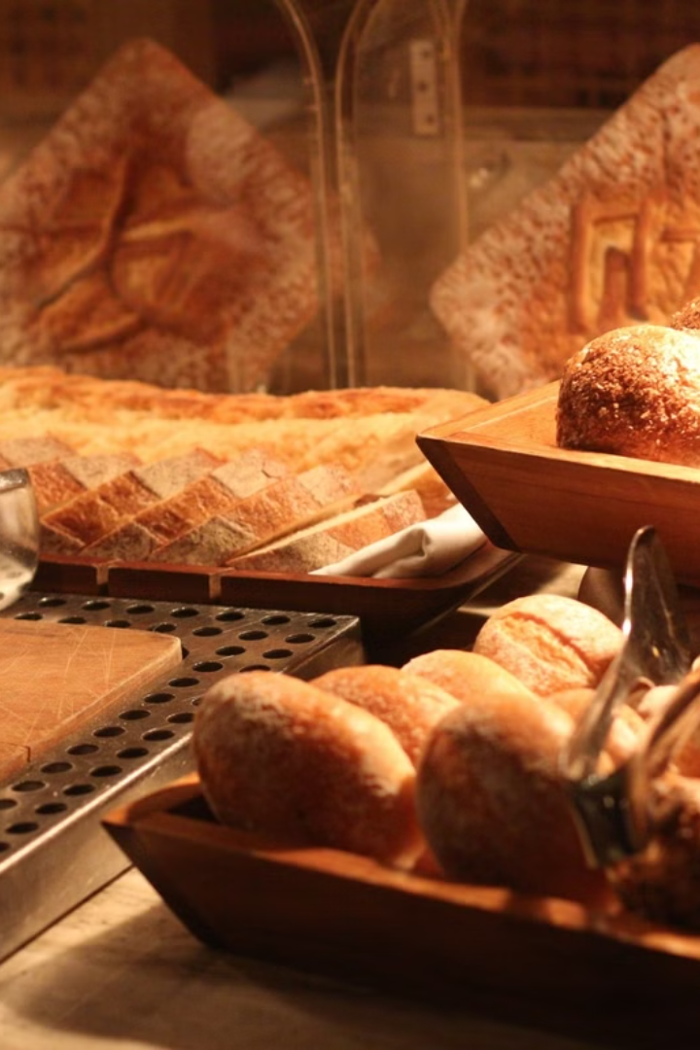
Our Story: From Passion to Pastry
The journey of [Bakery Name] began with a passion for baking and a commitment to quality and creativity. We use fresh, local ingredients and modern technology to create a better customer experience.

Slide 3
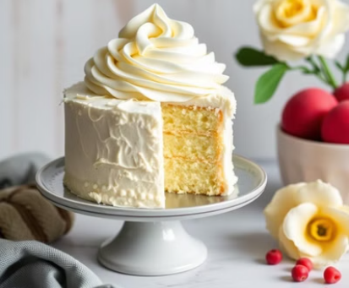

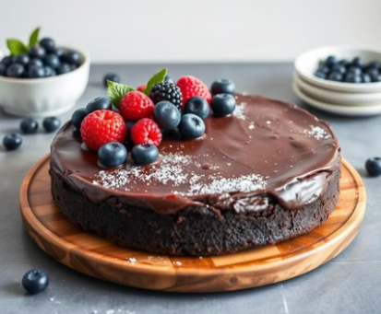
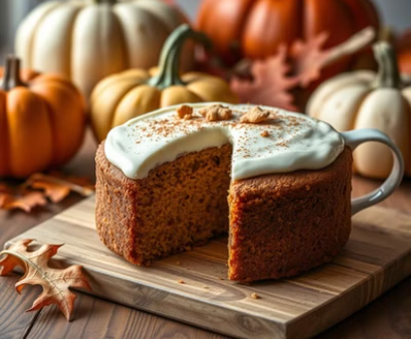
Indulge Your Senses: Our Cake Creations
Our cakes offer unique flavors and exquisite designs. Discover classic cakes, custom designs, vegan options, and seasonal specials!

Slide 4
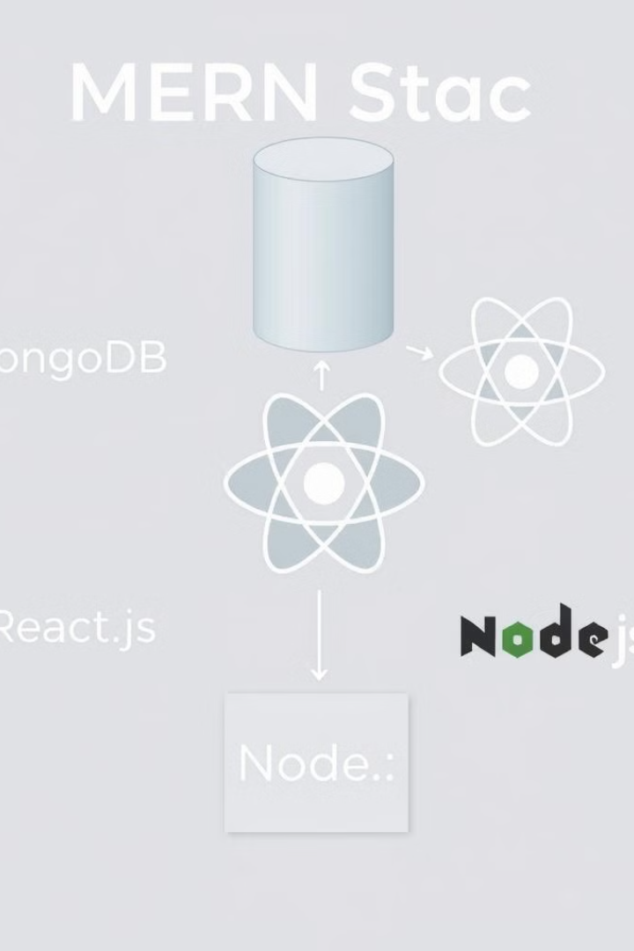
Behind the Scenes: Powering [ Dreamy Bakery ] with MERN
The MERN stack (MongoDB, Express.js, React, Node.js) powers our backend. MongoDB stores cake designs and customer info. Express.js handles backend requests. Node.js is our Javascript runtime.

Slide 5
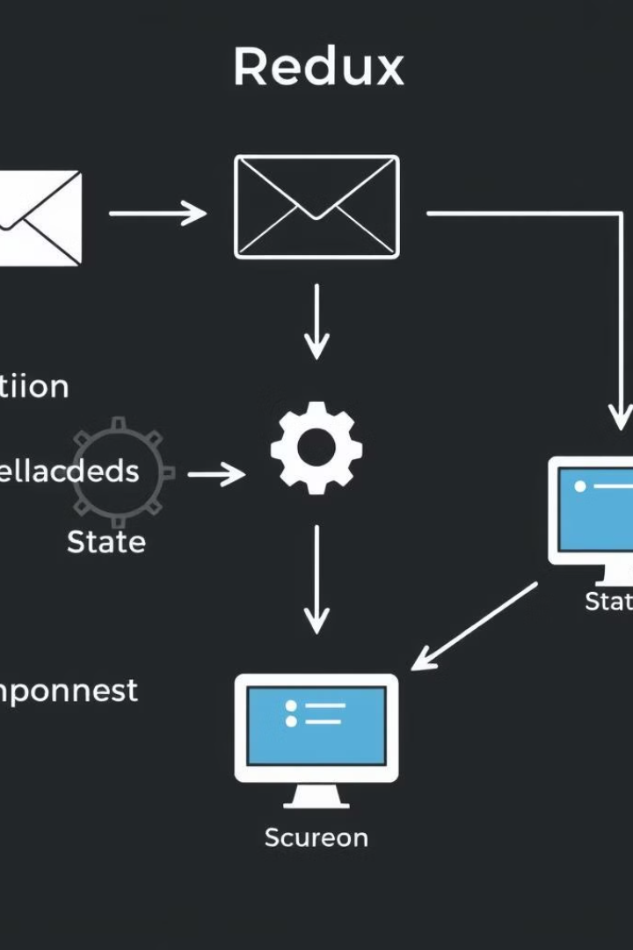
Perfectly Layered: Managing Complexity with Redux
Redux is essential for our state management.
Redux provides a centralized state container to manage cake inventory, order statuses, and user sessions. Predictable state updates enhance performance and maintainability.

Slide 6
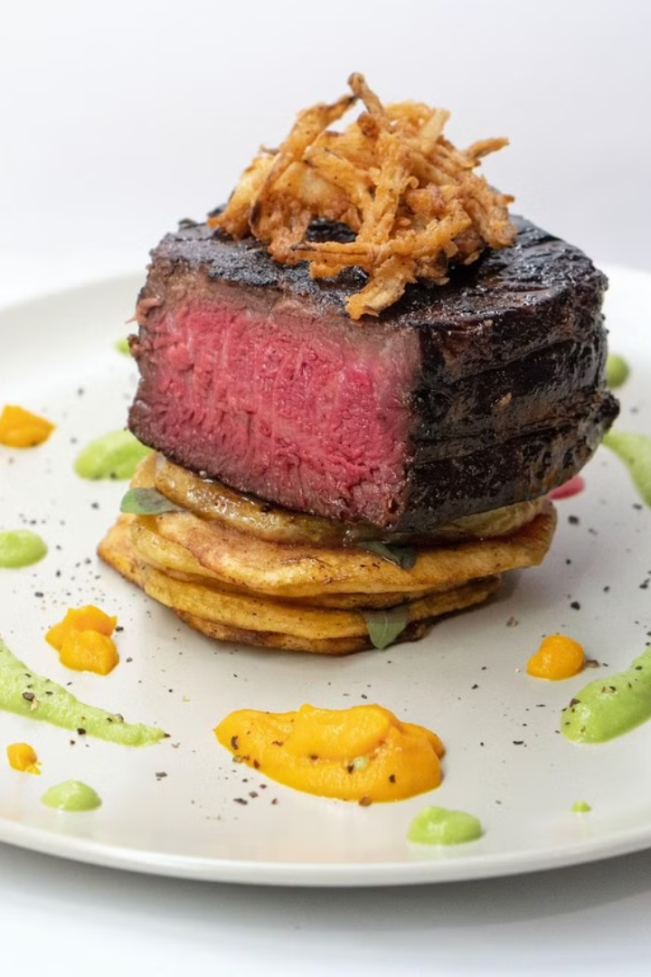
A Sweet Experience: Our Beautiful React Frontend
Easy cake ordering process.
Interactive cake design customization.
Secure payment gateway.
Delightful animations.
Our React frontend is user-friendly with animations and transitions.

Slide 7

Sprinkle of Magic: Enhancing the Experience with Animation
Animations enhance the user experience and brand.
Loading animations provide visual feedback. Smooth transition effects guide users. Interactive elements engage customers.

Slide 8
Get in Touch: Let's Create Something Delicious
Bakery Address
Phone Number
Email Address
Website URL
Social Media Links
Thank you! Visit us today or order your dream cake now!

